Slide 1
FWD Project
TOGAF 9 - Core Diagrams
Solution Concept Diagram
Phase A – Architecture Vision

Slide 2
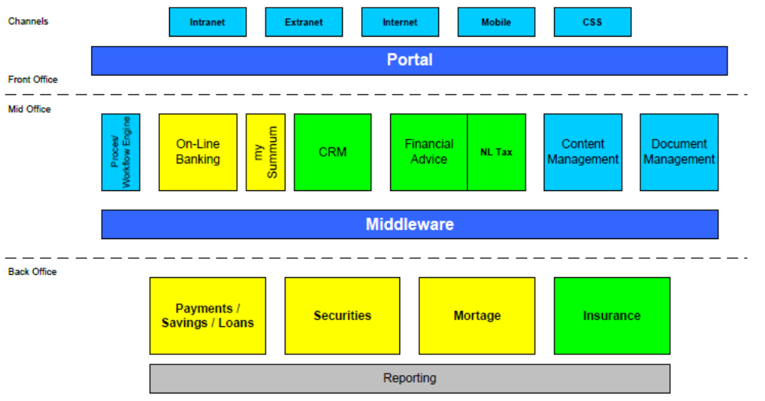
Solution Concept Diagram

Slide 3
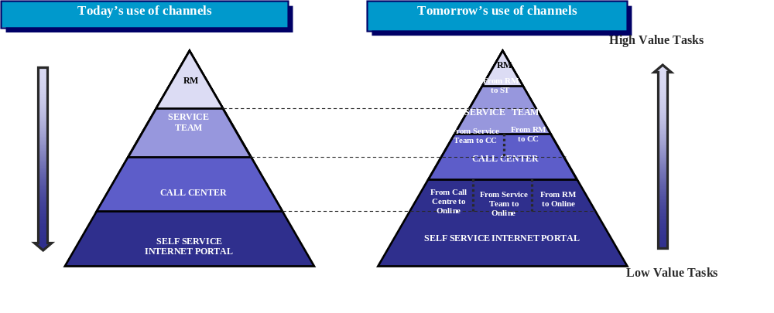
Solution Concept Diagram

Slide 4
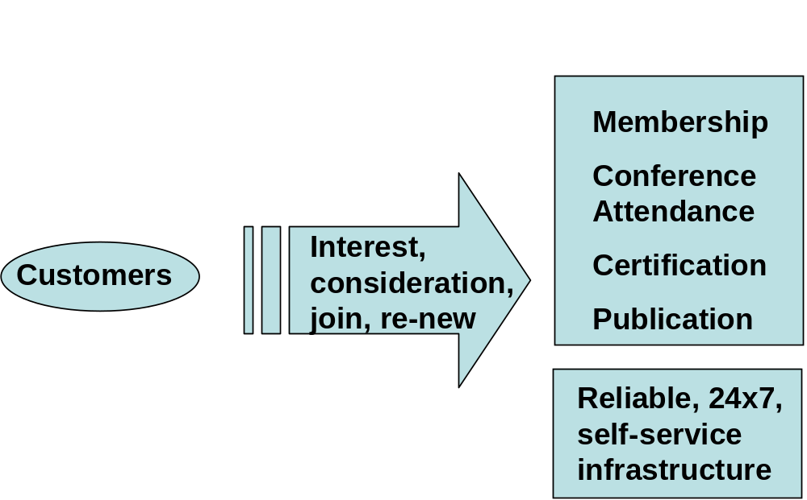
Solution Concept Diagram

